Slide 1
Digital portfolio
STUDENT NAME:Nithinraj.G
REGISTER NO :222403558
NMID : 8D7B36B5DA5FEC4A7FA4F7A511C7D6B2
DEPARTMENT : Computer science
COLLEGE:Sari devi arts And science college

Slide 2
Project title
College library management

Slide 3
Agenda
Problem Statement
Project Overview
End Users
Tools and Technologies
Portfolio design and Layout
Features and Functionality
Results and Screenshots
Conclusion
Github Link

Slide 4
Problem statement
Could you clarify what kind of problem statement you need?
👉 For example:
A project problem statement (like for your library management project)?
A research/problem-solving statement (like in assignments)?
Or a general definition/example of what a problem statement is?
If it’s for your College Library

Slide 5
Project overview
The College Library Management System is a web-based application designed to simplify the process of managing library records. It allows users to add new books, view available books, and store all details in a database. The system uses HTML, CSS for the frontend, and Java Servlets with MySQL for the backend.

Slide 6
Who are the end users
Students → to search and view available books.
Librarians/Library Staff → to add, manage, and update book records.
College Administrators → to monitor and generate reports.

Slide 7
Tools and techniques
Frontend: HTML, CSS (for user interface design)
Backend: Java Servlets (for processing requests)
Database: MySQL (for storing and retrieving book records)
Server: Apache Tomcat (for running the servlet application)
IDE: Eclipse/NetBeans (for coding and debugging)

Slide 8
Potfolio design and Layout
Simple and user-friendly layout
VIsual feedback (Book Added Successfully!, Book list in table)
Consistent styling with CSS
Easy to extend (delete/edit features can be added later)

Slide 9
Features and functionality
User Interface (HTML + CSS):
Simple and clean web form for managing books.
Users can input:
Book ID
Book Name
Author Name
Two buttons:
Add Book – to save book details
View Books – to display all stored books
Back-End Functionality (Java Servlet):
Add Book:
Takes form data and inserts it into the books table in the librarydb MySQL database.
View Books:
Retrieves and displays all books in a formatted HTML table.
Database Integration (MySQL):
Connects to a local MySQL database using JDBC.
Uses prepared statements for secure data handling.
Displays data dynamically from the database.
Design Highlights:
Responsive and centered form layout.
Stylish buttons with hover effects.
Table view for book listings.

Slide 10
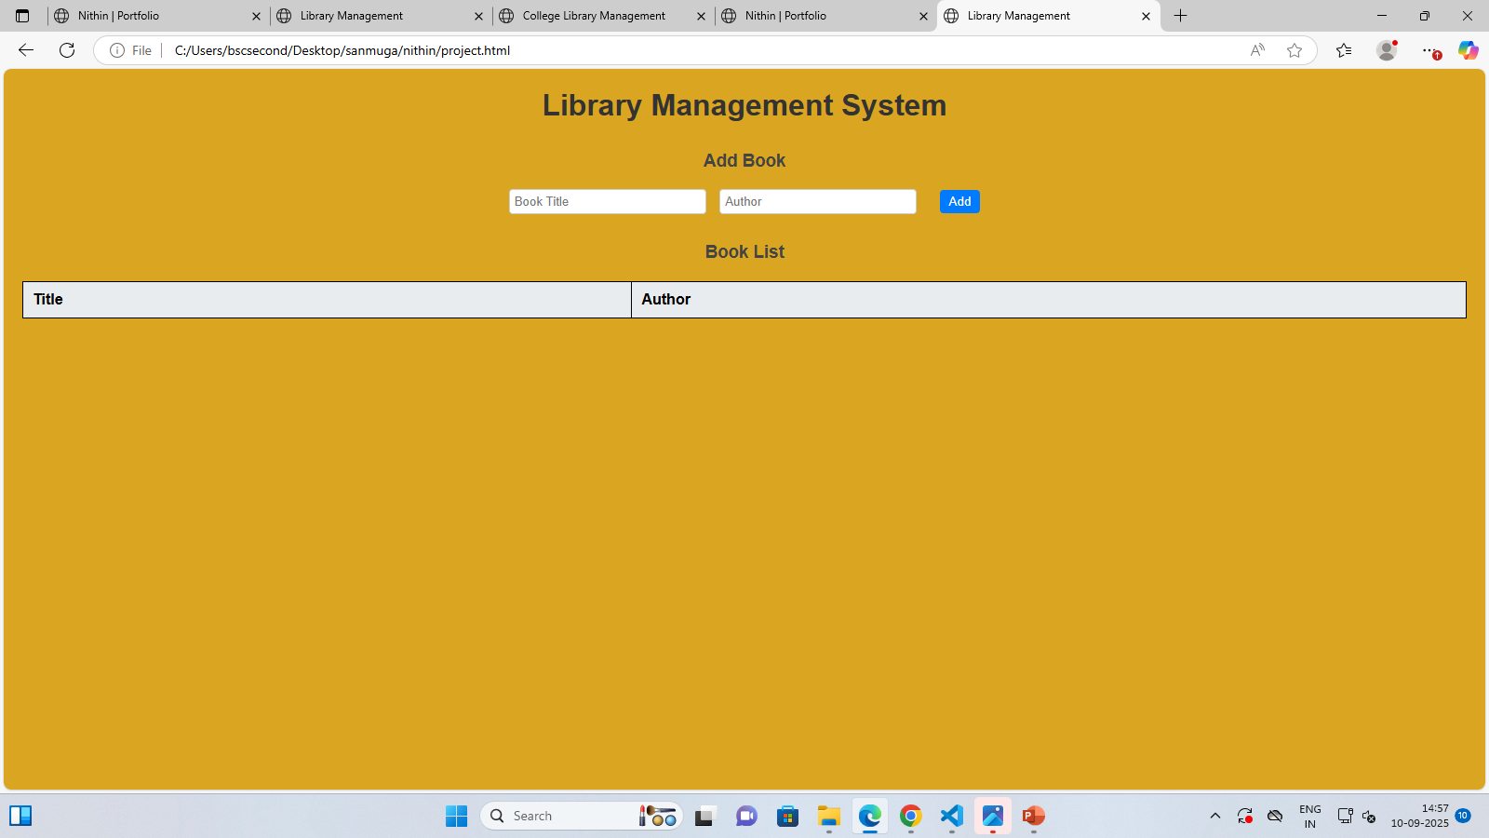
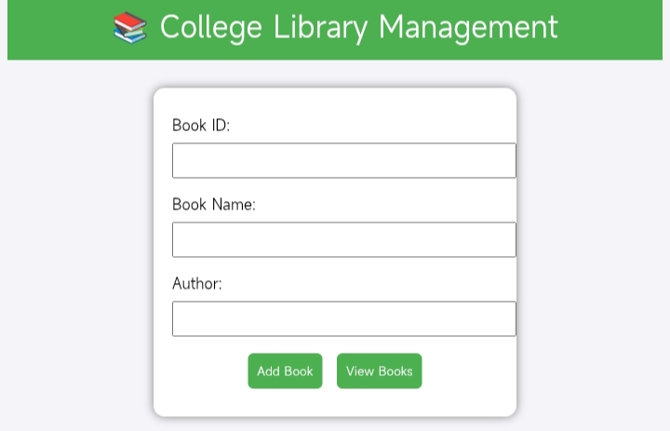
Results and screenshot
A College Library Management web app using
:HTML/CSS for the frontend
Java Servlet (LibraryServlet.java) for backend
MySQL database for storing books

Slide 11
Conclusion
The College Library Management System is a simple yet effective web application that allows users to add and view books using a clean interface. It integrates HTML, CSS, Java Servlets, and MySQL to manage library records efficiently. This project demonstrates basic CRUD operations, database connectivity, and form handling in a web environment, making it a useful tool for beginners in Java web development.

Slide 12
GitHub link
https://github.com/gnithinraj24135bsccs-dev/Nithinraj_222403558.git

